Slide 1

Development Environment and Software
Arduino IDE. Sketch. Functions. Debugging
SoftUni Team
Technical Trainers
Software University
https://softuni.bg

Slide 2

Table of Contents
Arduino IDE
Sketch
Basic Arduino IDE Functions
Basic Functions. Variables. Libraries
Debugging and Serial Communication
Serial Monitor
Examples

Slide 3

Arduino IDE
Introduction. Main View. Toolbar

Slide 4

Arduino IDE
Arduino Integrated Development Environment (IDE) is used to write and upload programs to Arduino compatible boards
Supports the languages C and C++
Start with Arduino IDE:
Download and install from: https://www.arduino.cc/en/software
Install needed Board Manager library and select your board
Select the correct COM port for the board
Note: for detailed instructions read the provided guidelines!

Slide 5
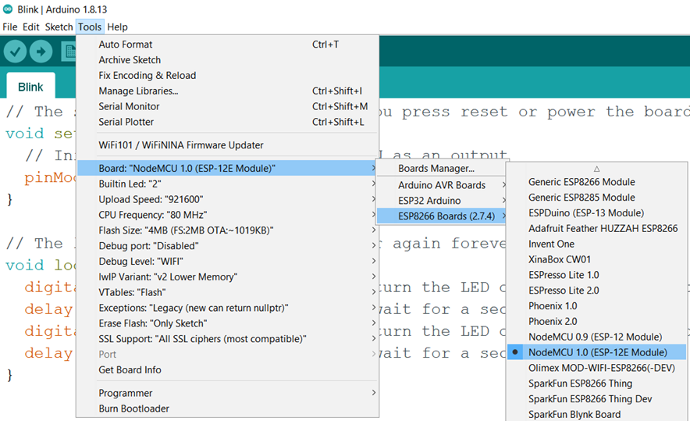
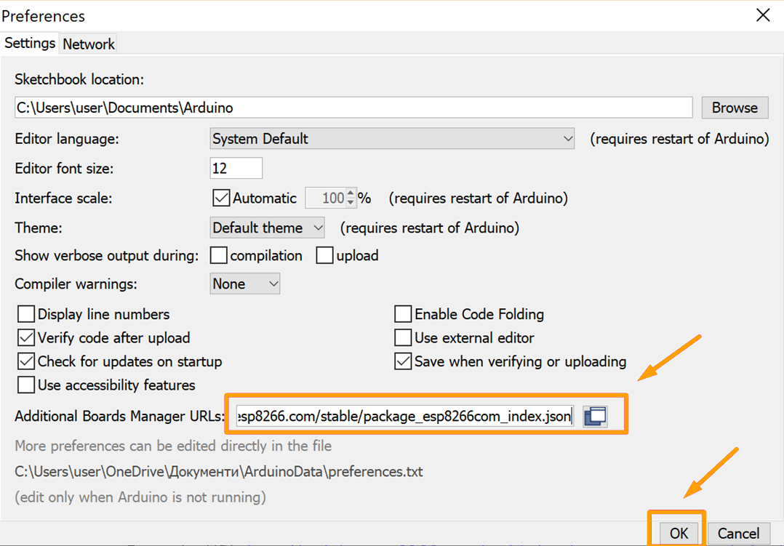
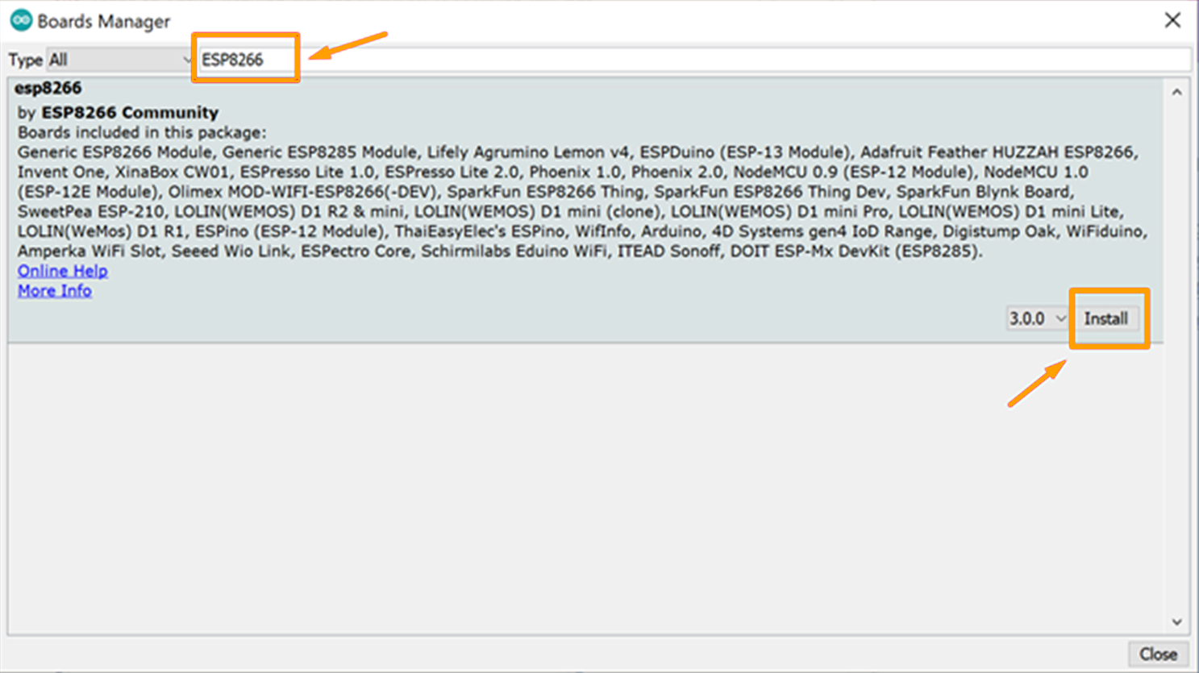
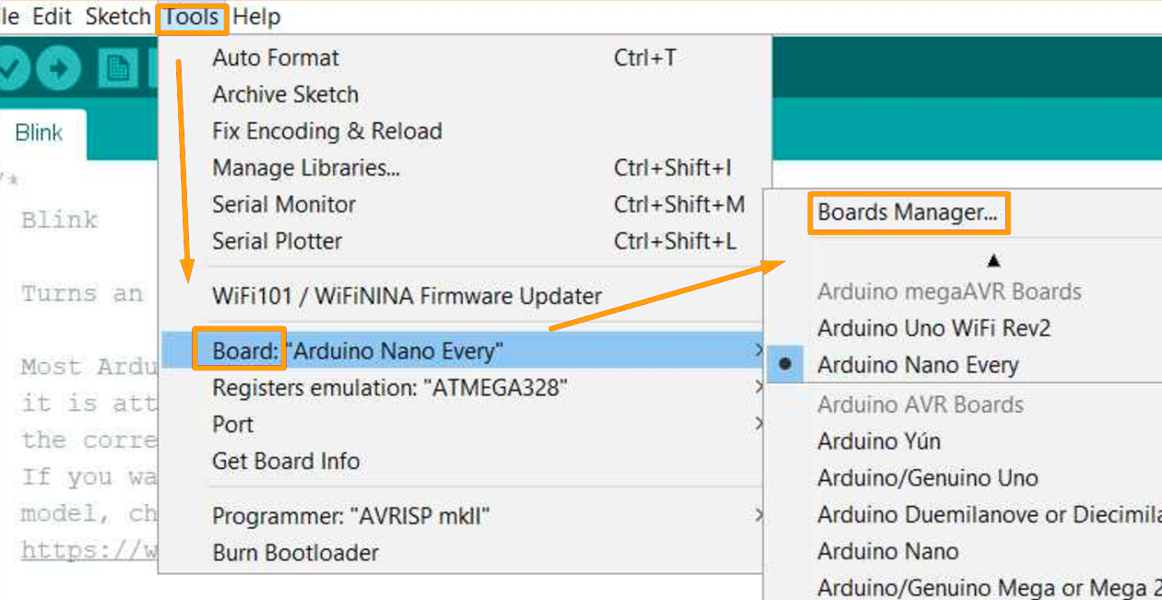
Select Your Board: NodeMCU 1.0

Slide 6
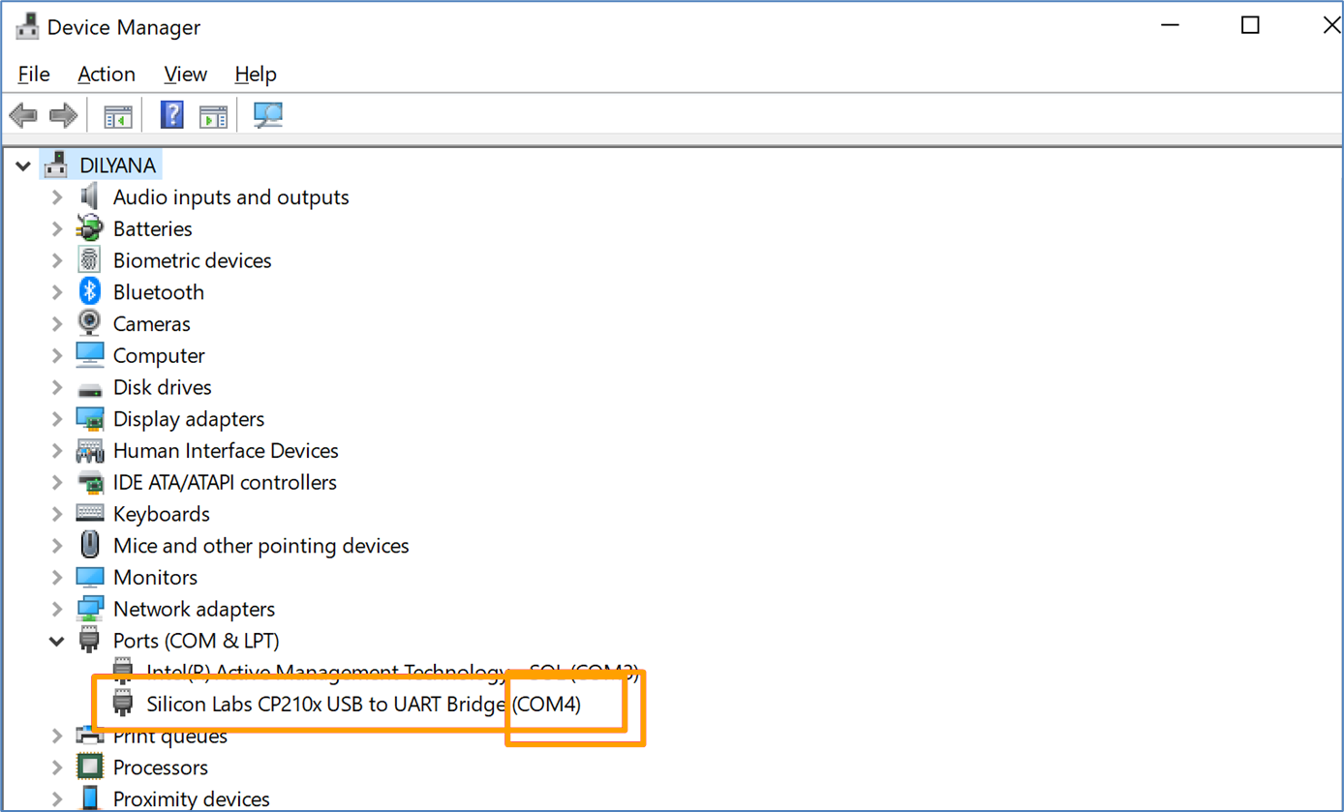
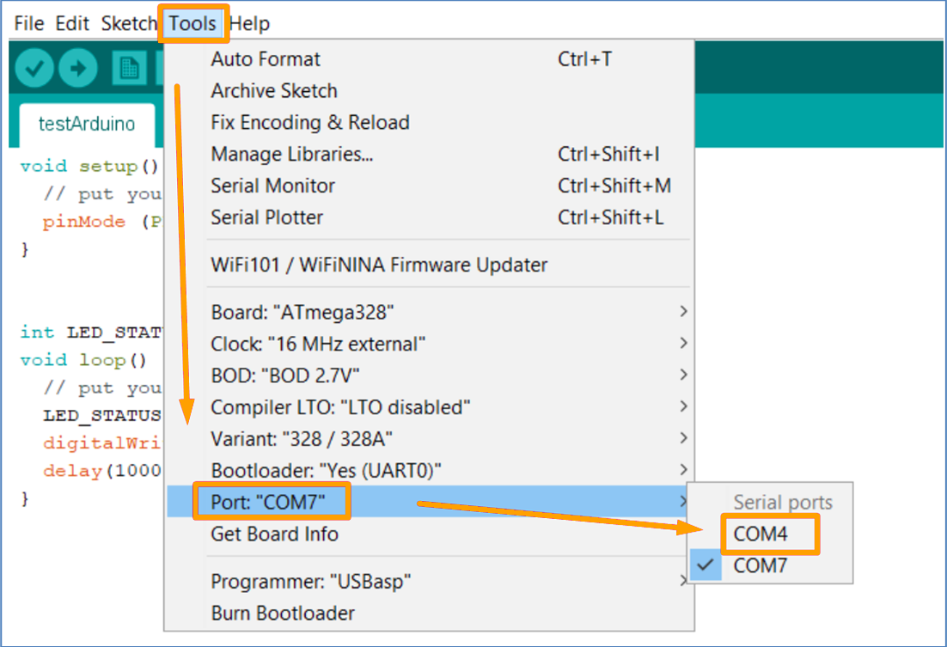
Select the Correct COM Port

Slide 7
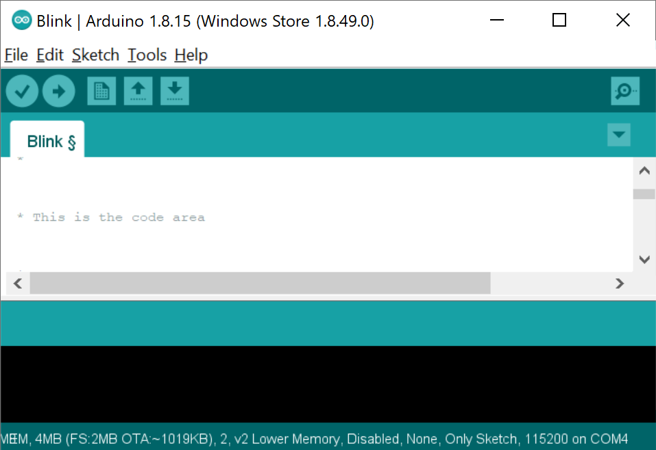
Arduino IDE – Main View
Arduino IDE version
Sketch name
Menus
Toolbar buttons
Code area
Upload status message
Messages from the system
Configured board and COM port

Slide 8
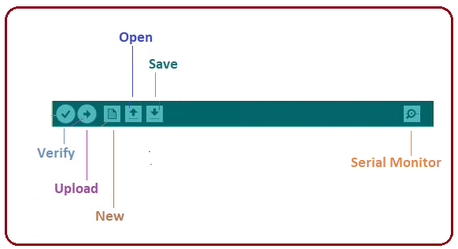
Toolbar Buttons
Verify – check the code for errors
Upload – compile and upload the code to the board
New – create a new sketch
Open – open a saved sketch
Save – save the sketch
Serial Monitor – display serial data sent from the board

Slide 9
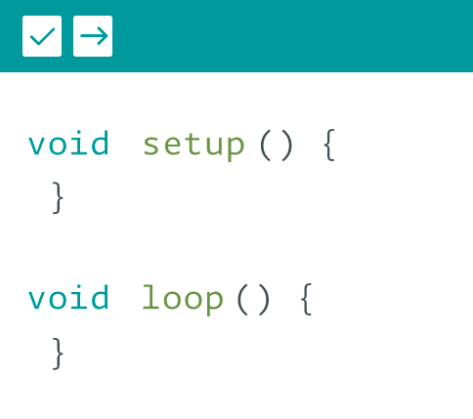
Sketch
Structure. Creating a Sketch

Slide 10
Sketch - Structure
The Sketch is the main code (program), created in Arduino IDE
Generates a Hex File which is uploaded on the board
Requires two basic functions:
void setup() {
// Initialization of variables, pin modes, libraries
// Runs only once after each power up or reset
}
void loop() {
// Loops the code consecutively
}

Slide 11
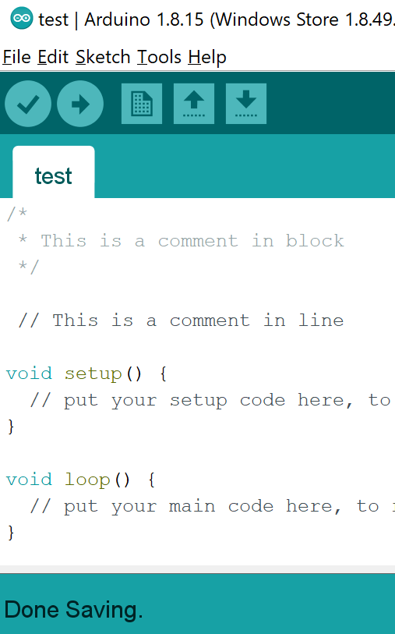
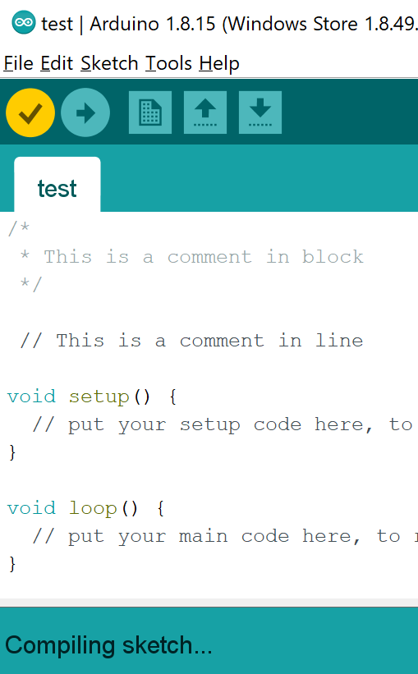
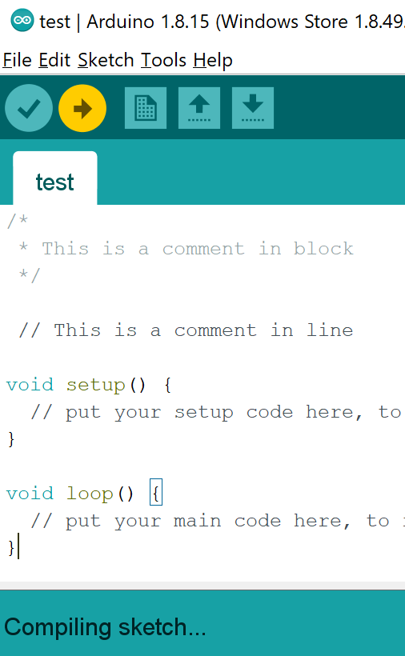
Creating a Sketch
Edit
Verify
Upload
Create new or open an existing sketch
Save the sketch
Verify if the sketch is compiling
Upload the sketch on the microcontroller
Edit here

Slide 12
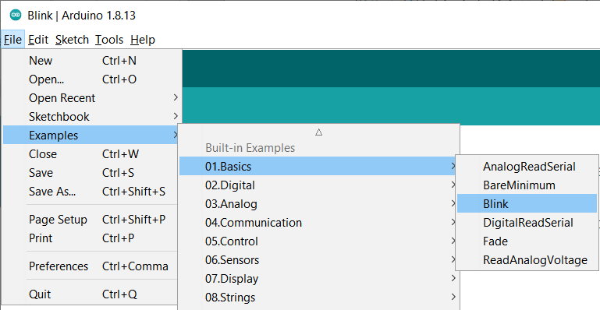
Arduino Examples
Arduino IDE has built-in code samples in Examples section:

Slide 13
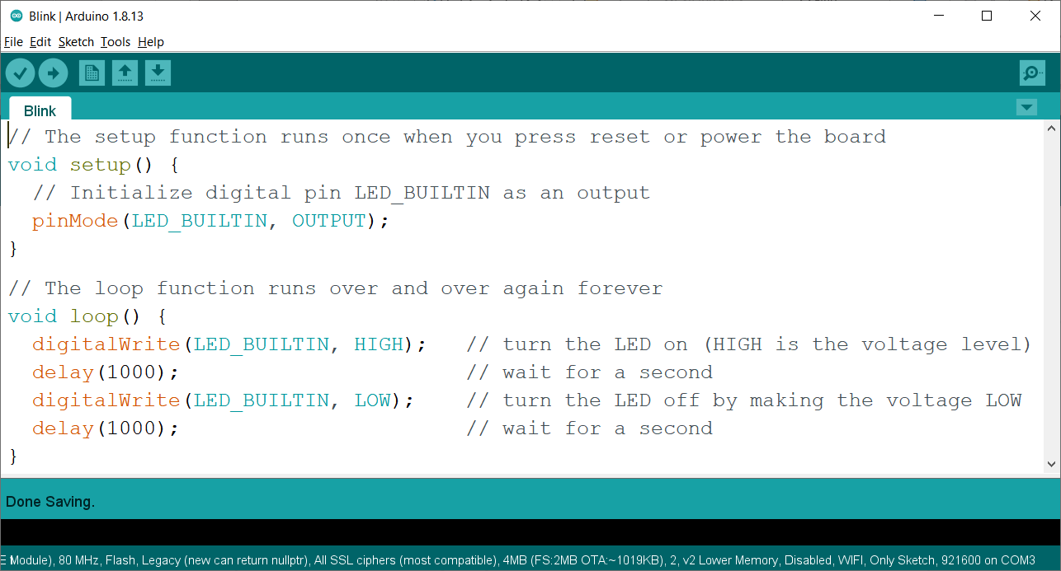
Opening Sketch – "Blink" Example

Slide 14
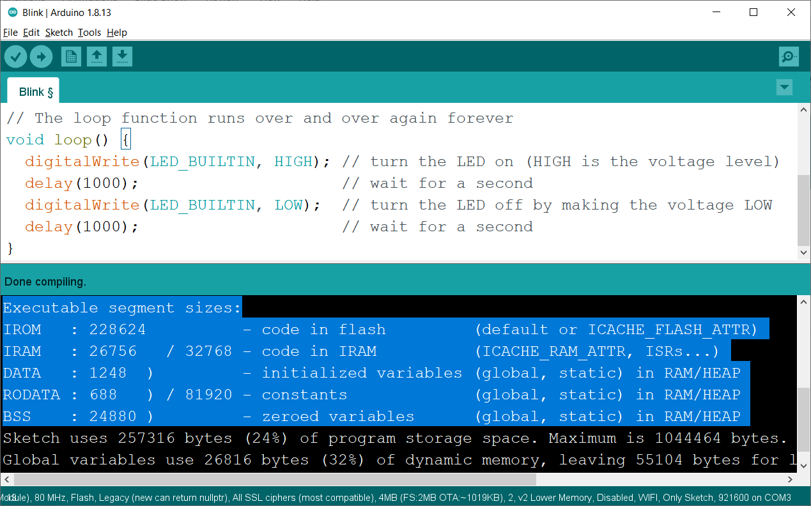
Compiling the "Blink" Example

Slide 15
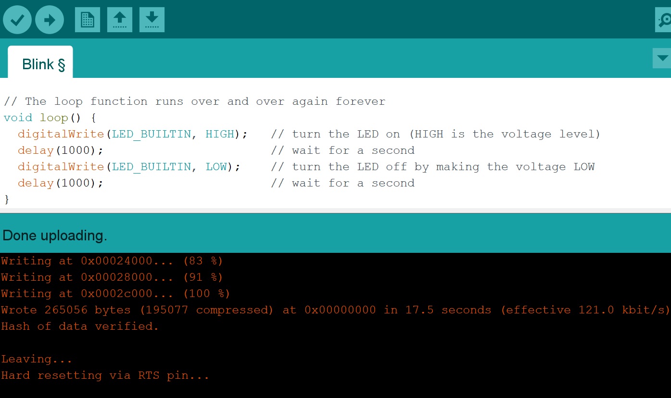
Uploading the "Blink" Example

Slide 16
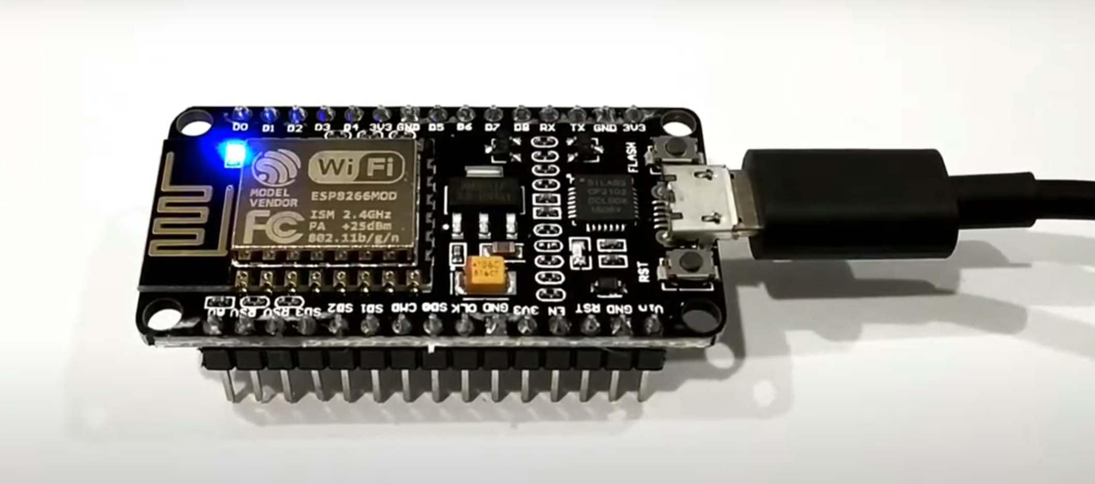
The "Blink" Example in Action

Slide 17


Basic Arduino IDE Functions
Basic IDE Functions. Variables. Libraries

Slide 18
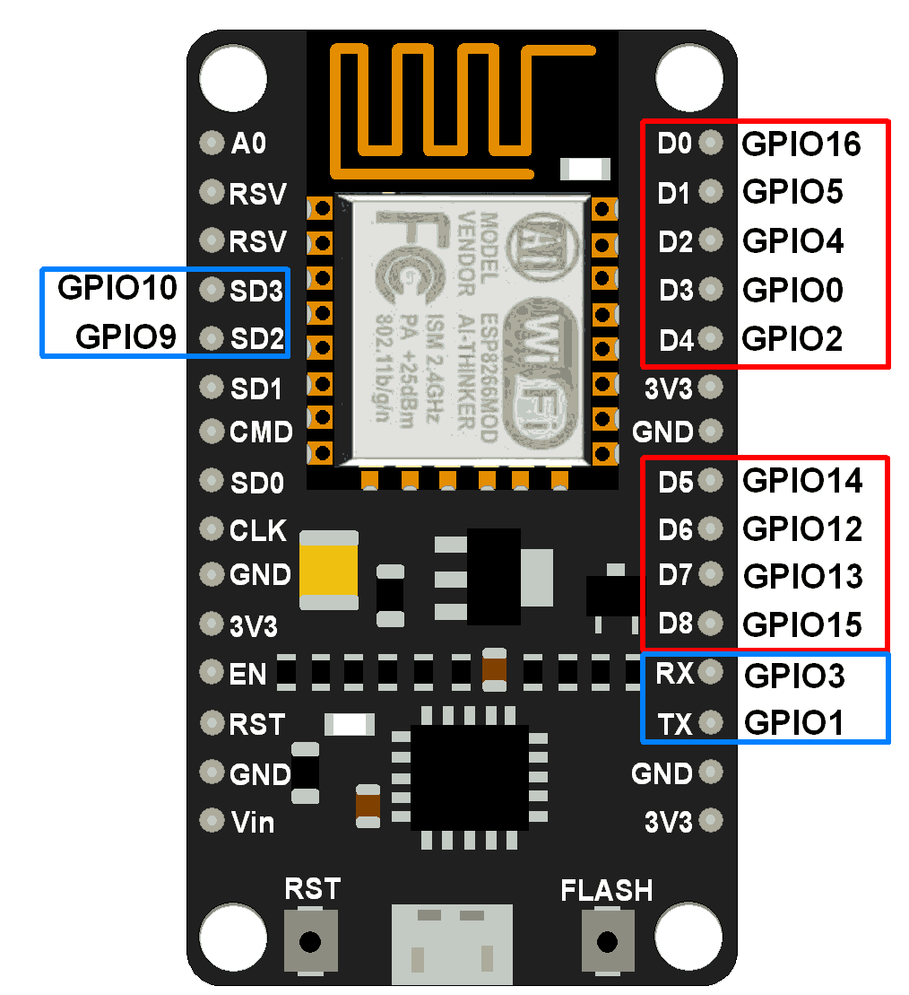
Hardware Related Functions
pinMode() – setup the I/O functions of hardware pins
digitalWrite() – set a pin to a digital level
digitalRead() – return the given pin value
delay() – pause for the given milliseconds
pinMode(2, OUTPUT)
pinMode(D4, INPUT)
digitalWrite(16, HIGH) / digitalWrite(D0, HIGH)
digitalRead(16) / digitalRead(D0)
delay(1000) // pause for 1 second

Slide 19
Flow-Control: If-Else, For, Do-While
Examples:
for loop
for (int i = 0; i <= 255; i++) {
analogWrite(PWMpin, i);
delay(10);
}
if (x > 120) {
digitalWrite(13, HIGH);
} else {
digitalWrite(13, LOW);
}
do-while
do {
delay(50);
x = readSensors();
} while (x < 100);
if – else construction

Slide 20
Variables
Variables – used for storing data (from sensors or a calculation)
Declaring variable – define its type and (optionally) set an initial value (initialize the variable)
Rollover – when variables exceed their maximum capacity, they "roll over" back to their minimum capacity and vice versa
int onboardLED = 16;
byte brightness = 13;
byte x;
x = 0;
x = x - 1; // x = 255
byte x;
x = 255;
x = x + 1; // x = 0

Slide 21
Variable Types
Type | Value Range | Size (Bytes)
boolean | True or False | 1
char | -128 to 127 | 1
byte | 0 to 255 | 1
int | -32768 to 32767 | 2
unsigned int | 0 to 65535 | 2
long | -2147483648 to 2147483647 | 4
unsigned long | 0 to 4294967295 | 4
float | -3.4028235E+38 to 3.4028235E+38 | 4
double | -3.4028235E+38 to 3.4028235E+38 | 4
String | Character array | -

Slide 22
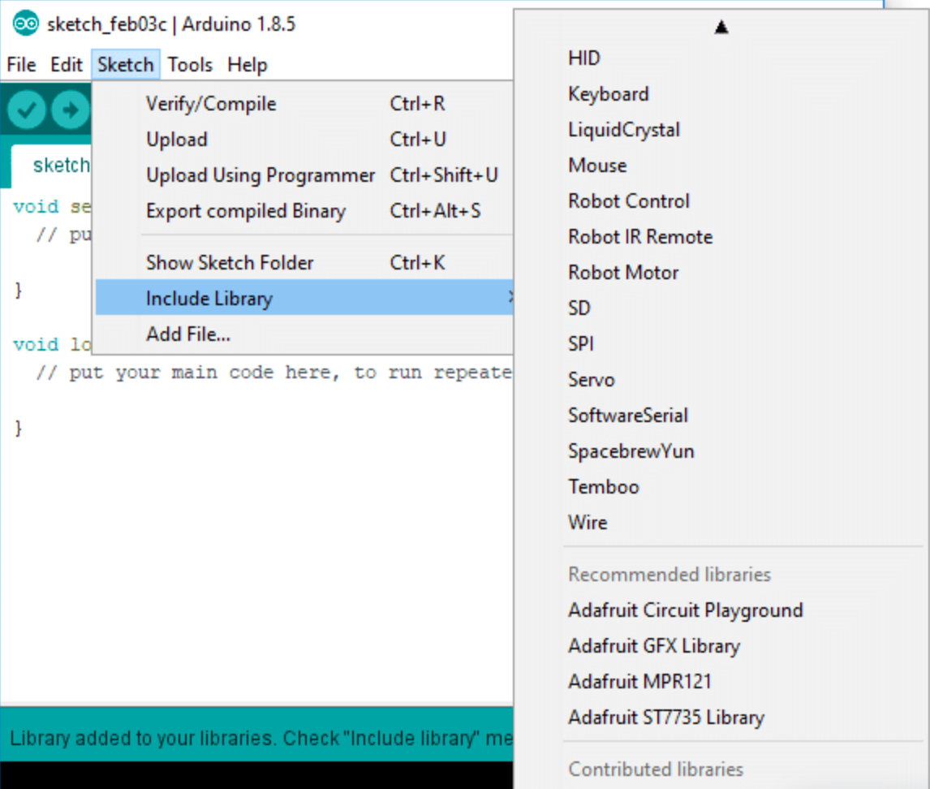
Libraries
Libraries provide extra functionality for use in sketches:
To connect with sensors
To manipulate data, etc.
Use a library from:
Sketch > Include Library
#include<> statement will be added to the sketch
#include <Servo.h>

Slide 23
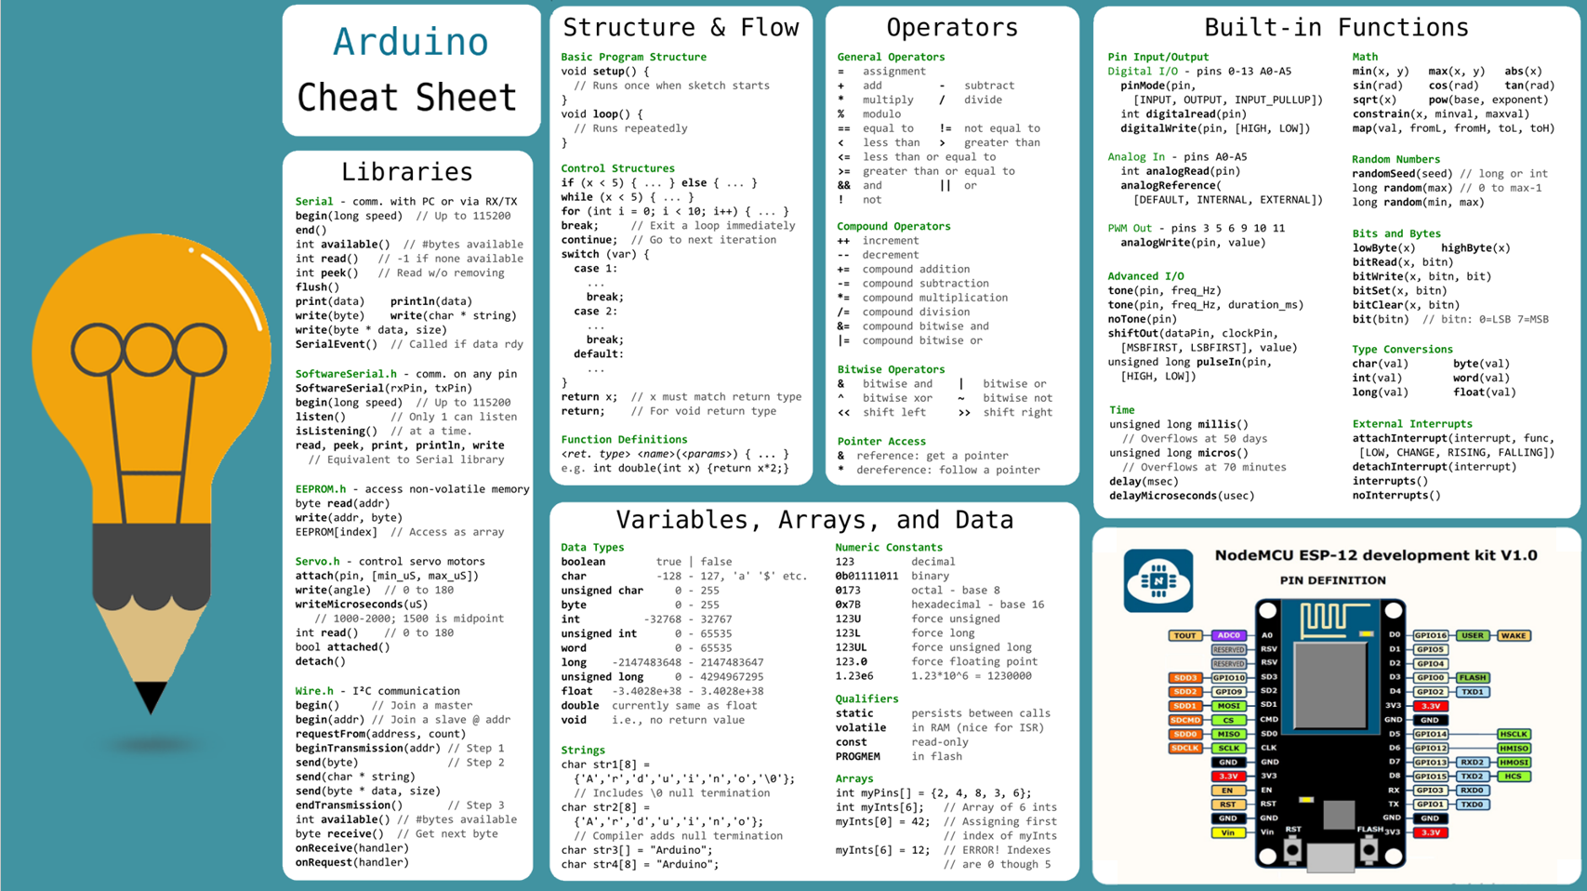

Slide 24
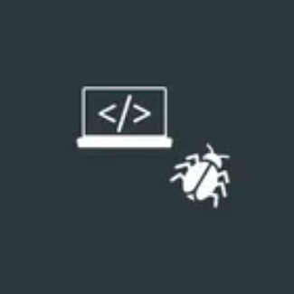
Debugging and Serial Communication
Serial Monitor

Slide 25
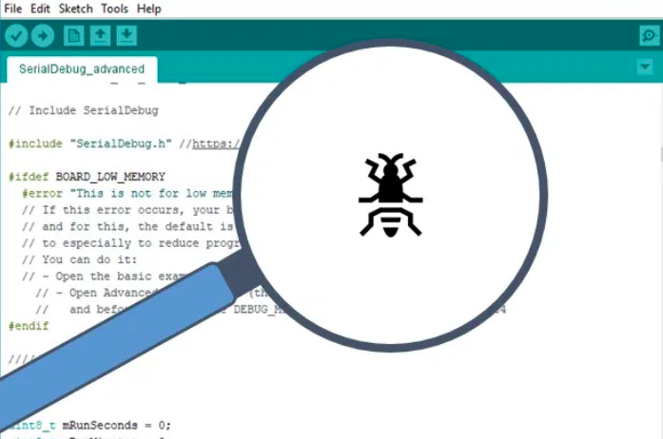
Debugging
Debugging in Arduino IDE is complicated
The code depends on outputs / inputs of a physical device
Debugging a sketch includes:
Checking the hardware:
wires, components, etc.
Trying to compile the code
Look for syntax errors
Code debugging with Serial Monitor:
Read data from the device at each code step

Slide 26

Serial Monitor
Serial Monitor displays messages sent from the microcontroller
Serial communications allow the microcontroller to interact with the computer and other devices
Serial.begin(baud rate) – start serial communication
baud rate – maximum transferred bits per second
Serial.println("{message}") – print message from the board
Serial.read() – read command from Serial Monitor
Serial.end() – close serial connection

Slide 27
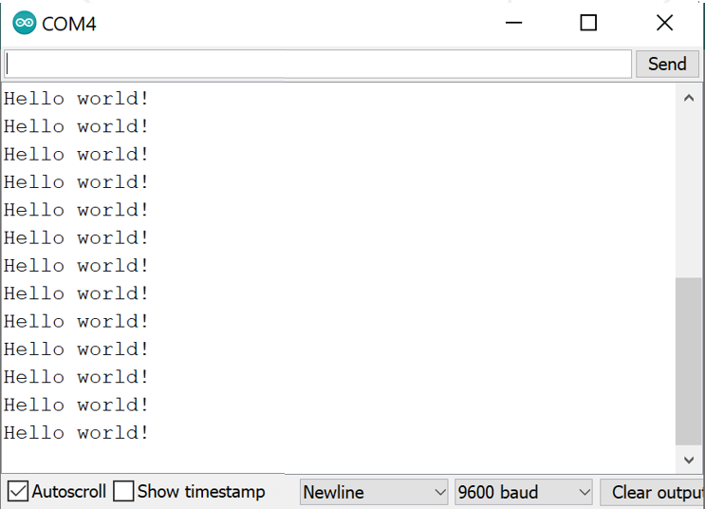
Serial Communication – Example
void setup() {
Serial.begin(9600);
}
void loop() {
Serial.println("Hello world!");
delay(1000);
}
Baud rate in the code
Set the same baud rate in the IDE

Slide 28
Serial.println(): Printing Text + Number
void setup() {
Serial.begin(9600);
}
void loop() {
for (int i=1; i<=100; i++) {
// This will fail!
Serial.println("i = " + i);
// Use: print("i = "); println(i);
delay(1000);
}
}

Slide 29

tinkercad.com
Online Arduino Simulator

Slide 30
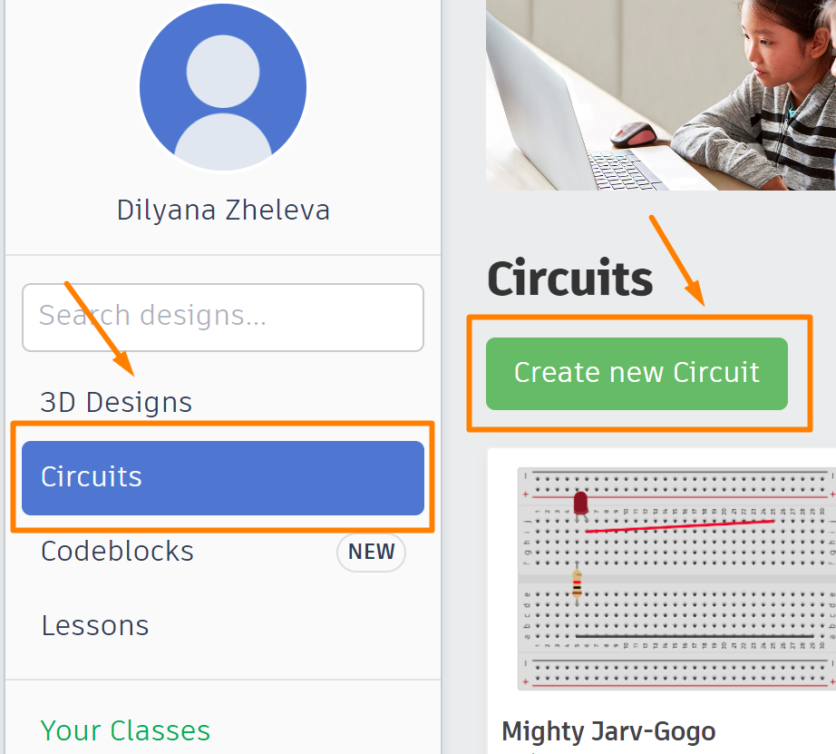
Tinkercad
Easy-to-use app for 3D design, electronics and coding
After registration, you can:
watch lessons with examples
build virtual circuits
run your Arduino sketch on the virtual Arduino board
NodeMCU ESP-12E is not supported!
There is real sketch Debugger!

Slide 31
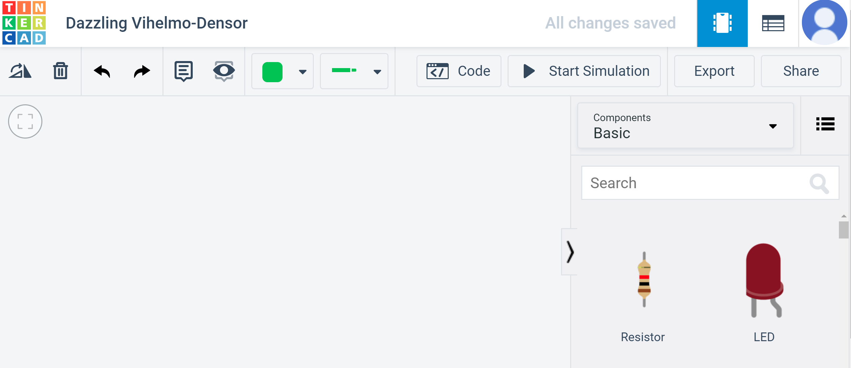
Tinkercad Simulator
Paste your sketch
Start simulation
Choose wire type and color
Search for circuit components
Drag and position the components here

Slide 32
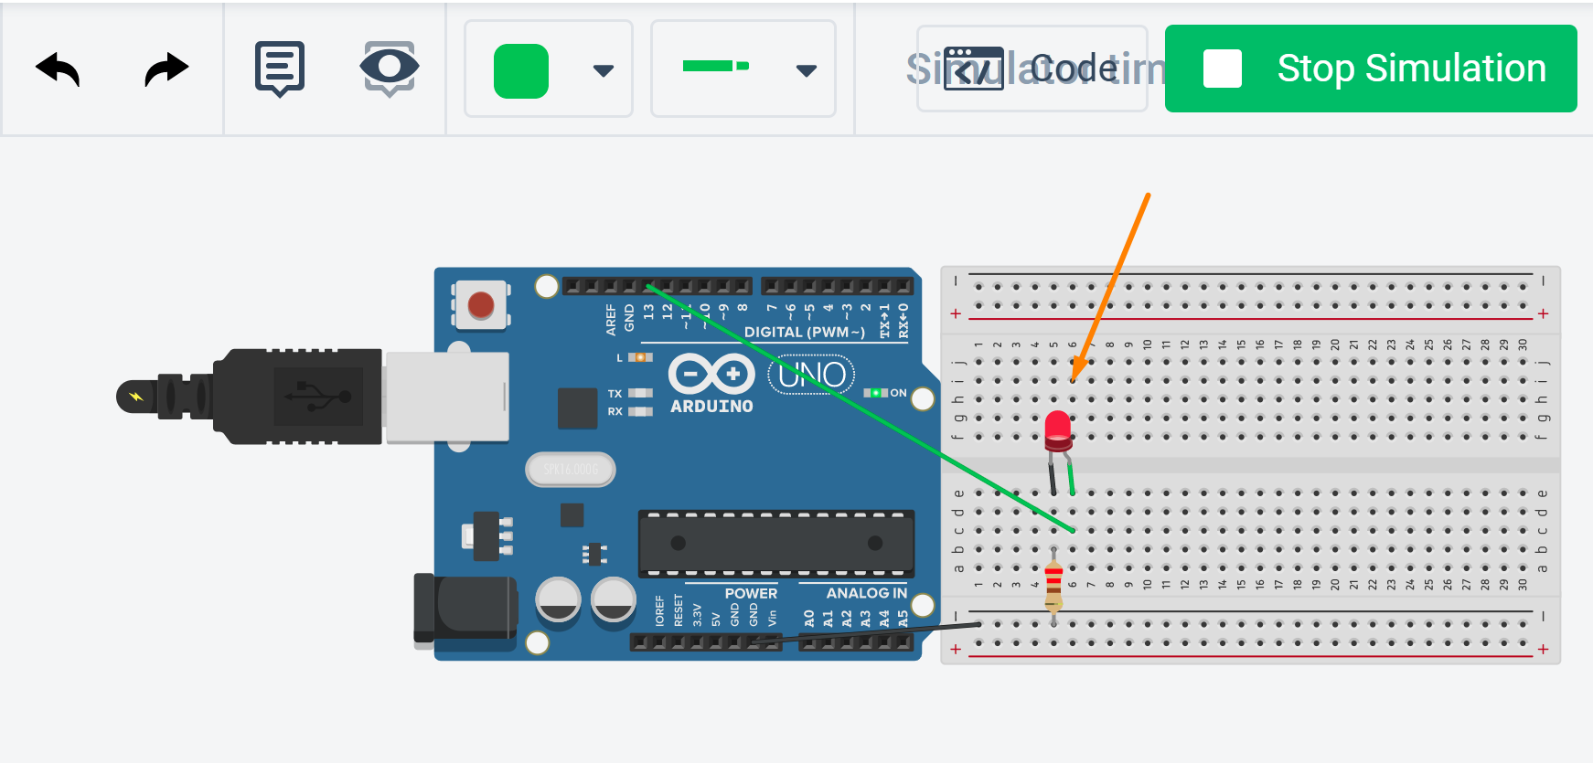
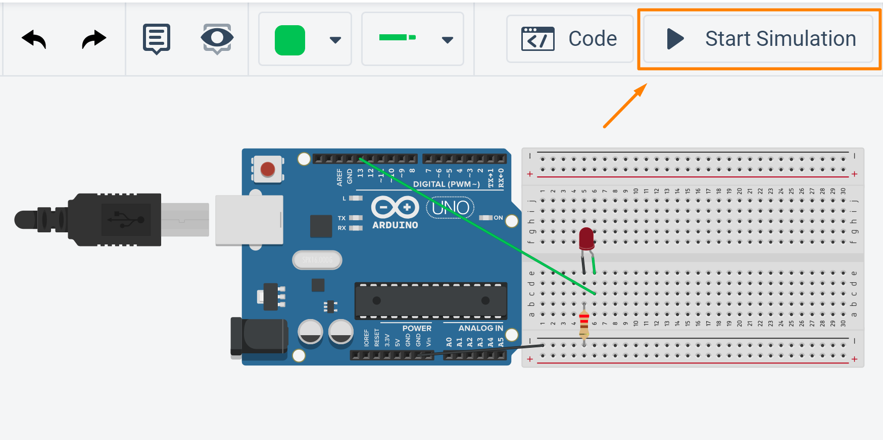
Tinkercad Simulator – Example

Slide 33
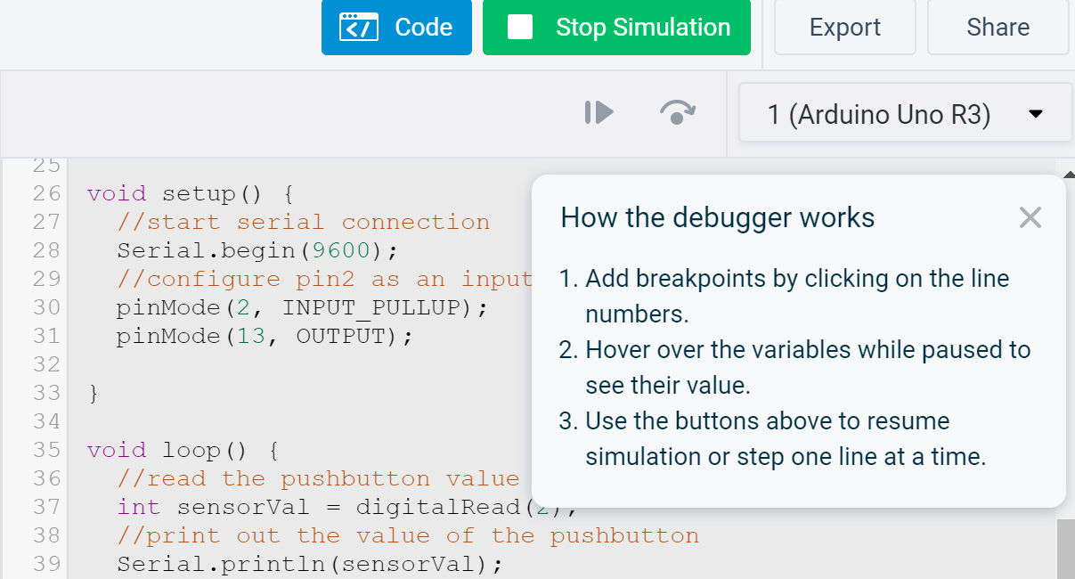
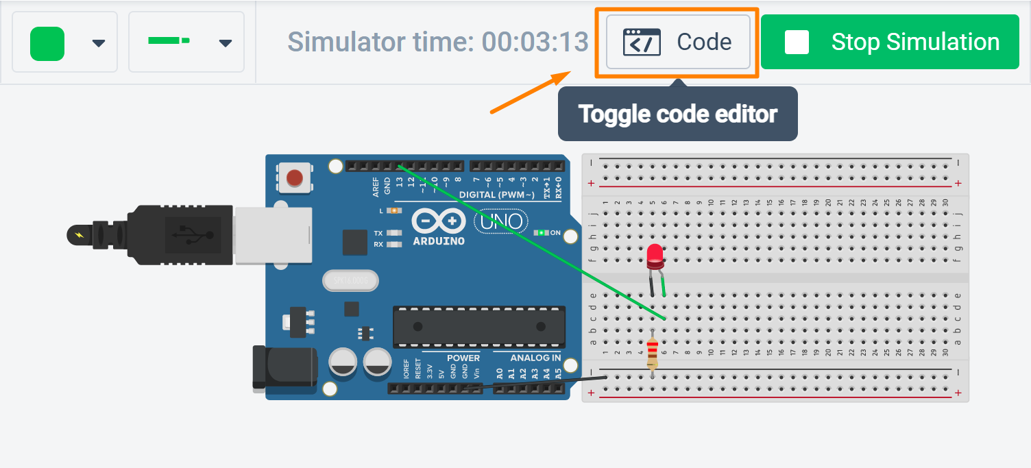
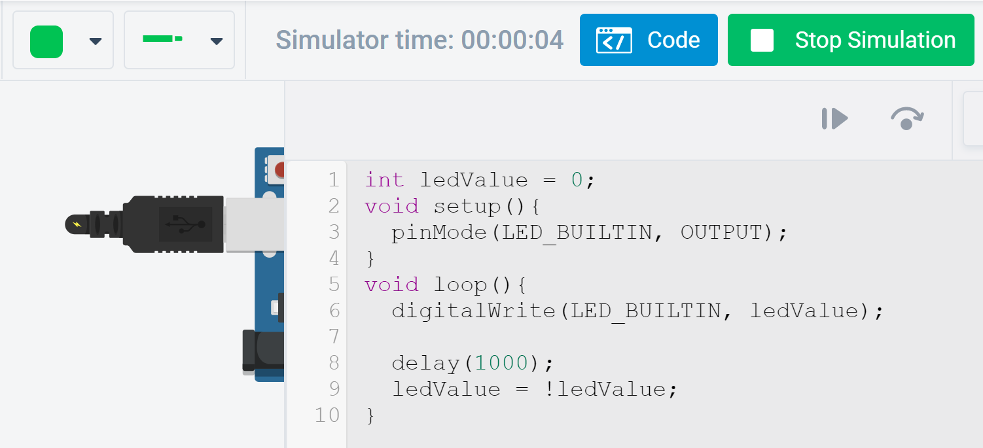
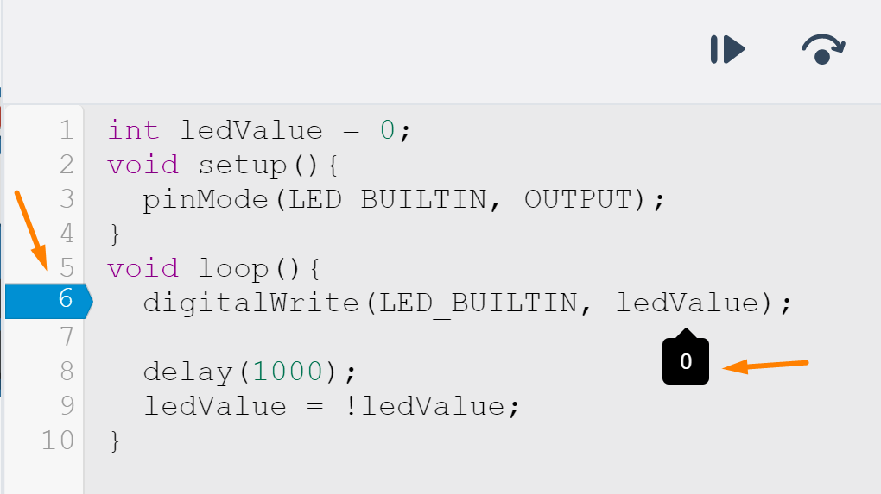
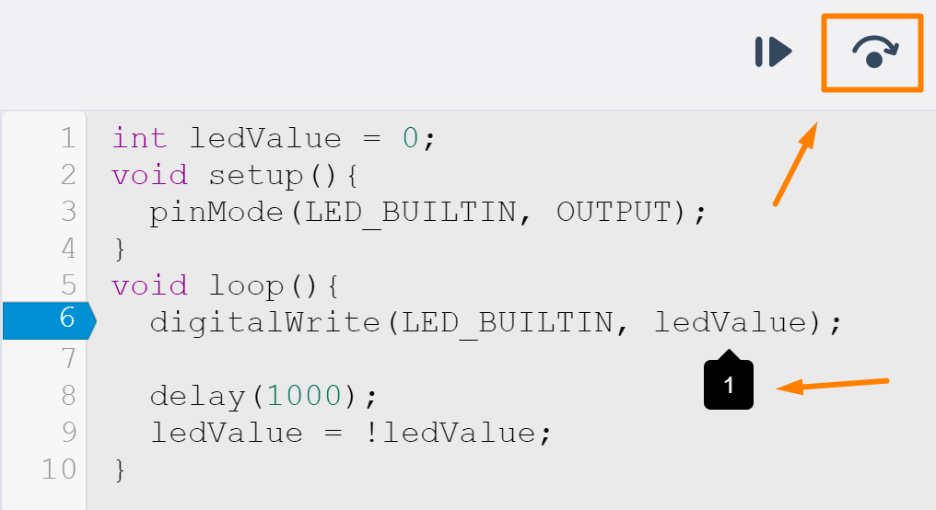
Tinkercad Simulator – Debugger
Use the button to go through the loop() method
Breakpoint on line 6
Read the debugger instructions
Buttons for pause and step over lines
ledValue = 1
ledValue = 0

Slide 34
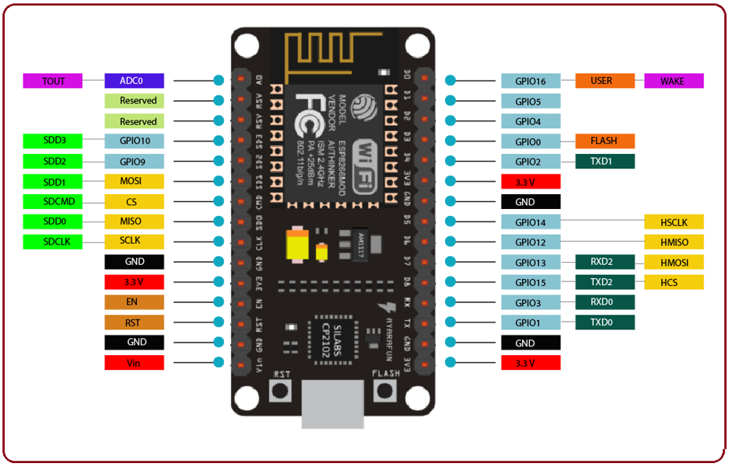
Examples

Slide 35
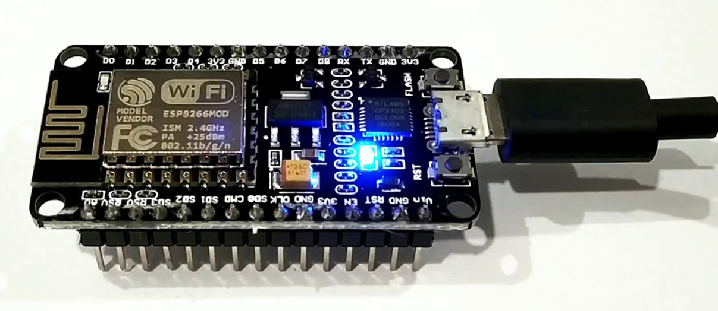
Internal LED Blink
Make the blue internal LED blink by keeping it ON for 1 seconds and OFF for 2 second
Warning: NodeMCU ESP-12E module has 2 build-in LEDs – on GPIO 2 and GPIO 16 (find the one, shown on the picture)
Connect the module to the computer and configure Arduino IDE to the correct COM port
Write the code
Verify if the code is compiling
Upload the sketch to the board
Note: The internal LED is ON on LOW voltage and OFF on HIGH voltage

Slide 36
Internal LED Blink – Solution
You can load sample code from: File > Examples > ESP8266 > Blink
In the example is used the built-in variable LED_BUILTIN, which is on GPIO2
In this case we use the LED on GPIO16
void setup() {
pinMode(16, OUTPUT);
}
void loop() {
digitalWrite(16, LOW);
delay(1000);
digitalWrite(16, HIGH);
delay(2000);
}

Slide 37
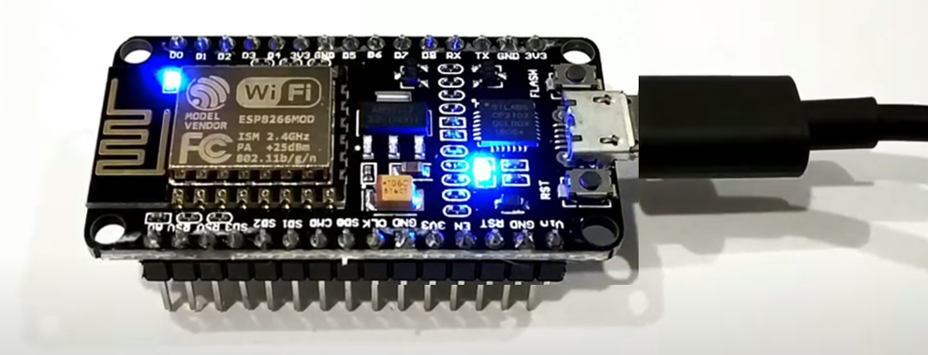
Double Blink
Make the Built-in and the Onboard internal LEDs blink together
First turn them ON and then OFF on 2 seconds intervals
After each blink reduce the interval with 50 ms
When the interval becomes 100 ms, begin again from 2 s

Slide 38
Double Blink – Solution
int LED1 = 2;
int LED2 = 16;
int interval = 2000;
void setup() {
pinMode(LED1, OUTPUT);
pinMode(LED2, OUTPUT);
}
void loop() {
while (interval > 100) {
digitalWrite(LED1, LOW);
digitalWrite(LED2, LOW);
delay(interval);
digitalWrite(LED1, HIGH);
digitalWrite(LED2, HIGH);
delay(interval);
interval = interval - 50;
}
interval = 2000;
}

Slide 39
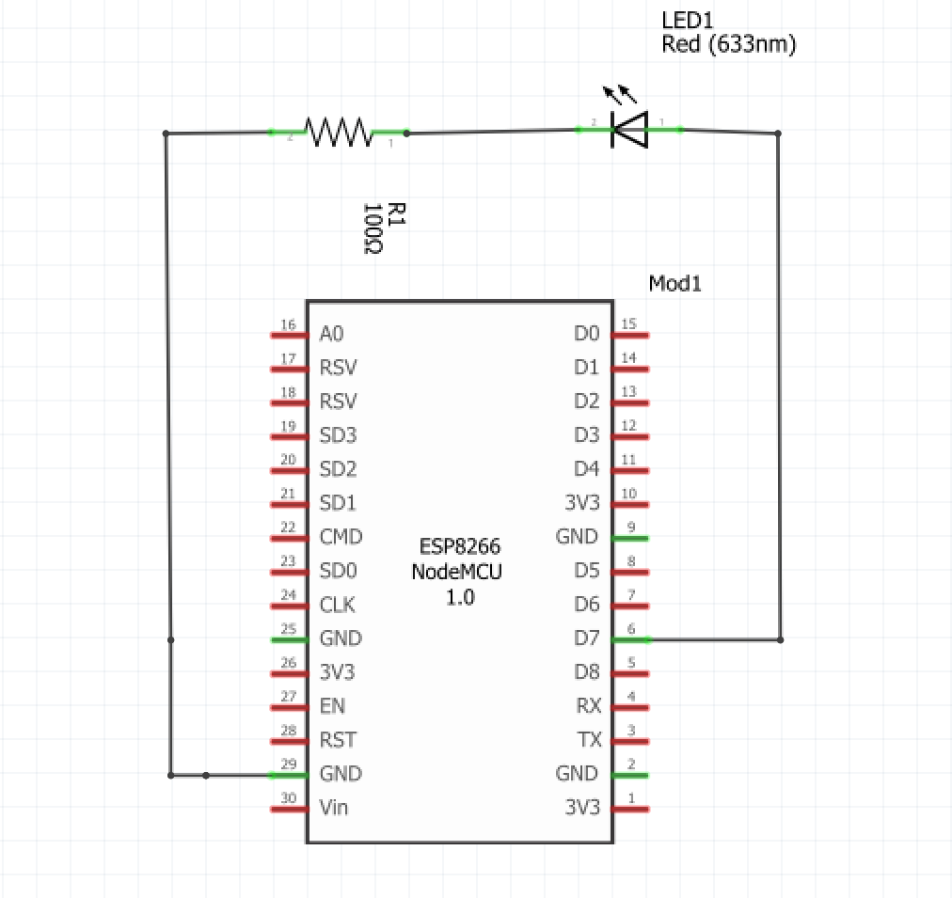
External LED Blink
Use the diagram to create a circuit with an external LED
Use 100 Ohm resistor or higher
Program the LED to turn ON and OFF every 0.5 s
After every fifth blink turn OFF the LED for 2 s instead of 0.5 s

Slide 40
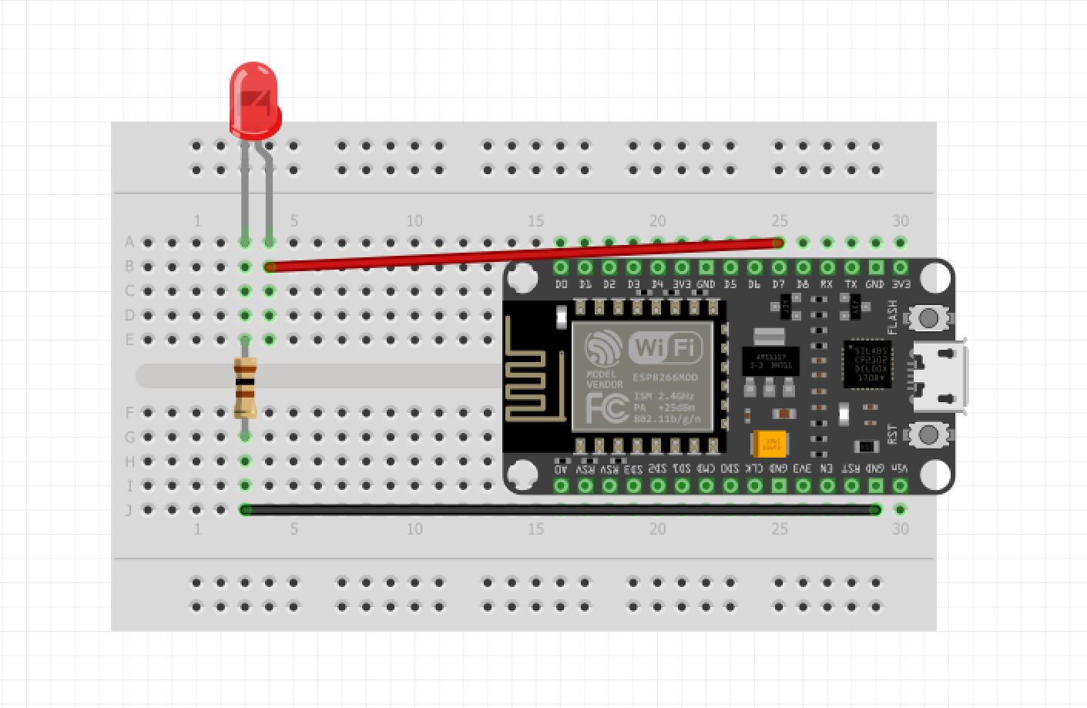
External LED Blink – Solution
void loop() {
blinkCounter++;
digitalWrite(LED, 1);
delay(500);
digitalWrite(LED, 0);
if (blinkCounter % 5 == 0) {
delay(2000);
} else {
delay(500);
}
}
int LED = D7; // GPIO 13
int blinkCounter = 0;
void setup() {
pinMode(LED, OUTPUT);
}

Slide 41
Summary
Arduino IDE is software for programming microcontroller boards
It needs to be configurated for the NodeMCU ESP-12E module
On each connection the COM port of the device should be checked
Sketch is the main program, uploaded to the board. It needs 2 main methods:
void setup() – runs only once at the beginning
void loop() – runs repeatedly
Arduino IDE has build-in libraries and functions for programming controllers:
pinMode(), digitalRead(), digitalWrite(), delay()…
The main code debugging method is by using Serial Communication and checking the messages in the Serial Monitor tool. Commands for serial communication:
Serial.begin(), Serial.println(), Serial.end()
…
…
…

Slide 42
Questions?

Slide 43

License
This course (slides, examples, code, demos, exercises, tutorials, homework, projects, documents, videos and other assets) is copyrighted content, created by SoftUni
Unauthorized copy, reproduction or use is illegal
© SoftUni – https://softuni.org
© Software University – https://softuni.bg

